Slide 1
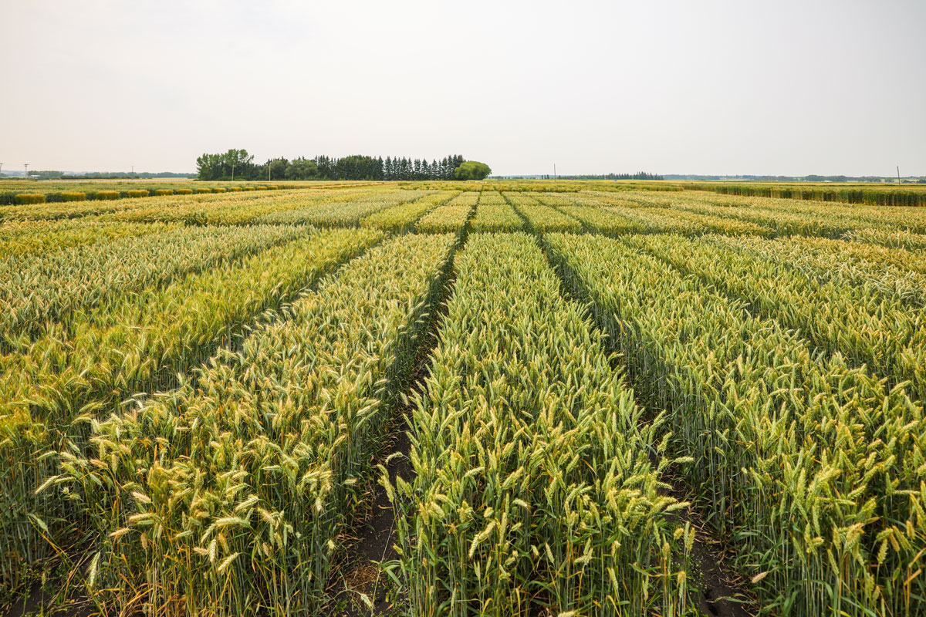

Crop Rotation :
Mother Nature’s Take on Optimization
Presented by Michelle, Vinay, Valentin, Joshua & Tomy
In Partnership with Saskatchewan Ministry of Agriculture
Notes:
Intro: Food production, we’ve seen it with BalancedMilk
Let’s take a step back and deep dive in a step that occurs way before the milk distribution challenges…. Growing the crops that are going to feed these cows!

Slide 2
Making the Case for Crop Rotation
Monoculture Brings a Lot of Challenges...
Pests and insects' damages
Soil nutrient depletion
Weather conditions

Slide 3
Making the Case for Crop Rotation
Monoculture Brings a Lot of Challenges...
…That Crop Rotation Can Address
Pests and insects' damages
Disrupt reproductive cycles
Soil nutrient depletion
Benefits from nutrient uptake and nitrogen fixation in soil
Weather conditions
Enhance crop resilience

Slide 4
Making the Case for Crop Rotation
Monoculture Brings a Lot of Challenges...
…That Crop Rotation Can Address
Pests and insects' damages
Disrupt reproductive cycles
Soil nutrient depletion
Benefits from nutrient uptake and nitrogen fixation in soil
Weather conditions
Enhance crop resilience
Crop Rotation is the way forward to a more sustainable and profitable food production

Slide 5
Taking Crop Rotation a Step Further
What do we aim to do?
Monoculture
Evolution of agriculture
Prone to insects, diseases, and soil depletion
Rotational Culture
Resilient, productive & sustainable
Optimized Rotational Culture
Resilient, more productive & more sustainable
Notes:
So now that we have make the case for crop rotation and that you understood that it is better, lets make it even better and more productive
At this point of the presentation, you might tell us that crop rotation is a well known approach. Sure. But but it hasn’t been optimized for yet. We are not here to reivent the wheel, but we have some suggestion to modernize it!

Slide 6




Taking Crop Rotation a Step Further
What do we aim to do?
Why is Saskatchewan the place to start?
Monoculture
It starts here
Our knowledge of the country, paired with our will to make a difference in Canada led us to choose Saskatchewan
Evolution of agriculture
Prone to insects, diseases, and soil depletion
Rotational Culture
Saskatchewan is the biggest crop harvester
Referred to as the breadbasket of Canada, Saskatchewan accounts for 40% of total crop production
Resilient, productive & sustainable
Government is pushing for sustainability
Over the last few years, the government has been funding research, providing resources, and is now attributing subsidies (470 M$) for green farming
Optimized Rotational Culture
Resilient, more productive & more sustainable
Notes:
So now that we have make the case for crop rotation and that you understood that it is better, lets make it even better and more productive
At this point of the presentation, you might tell us that crop rotation is a well known approach. Sure. But but it hasn’t been optimized for yet. We are not here to reivent the wheel, but we have some suggestion to modernize it!

Slide 7
Taking Crop Rotation a Step Further
What do we aim to do?
Why is Saskatchewan the place to start?
Monoculture
It starts here
Our knowledge of the country, paired with our will to make a difference in Canada led us to choose Saskatchewan
Evolution of agriculture
Prone to insects, diseases, and soil depletion
Rotational Culture
Saskatchewan is the biggest crop harvester
Referred to as the breadbasket of Canada, Saskatchewan accounts for 40% of total crop production
Resilient, productive & sustainable
Government is pushing for sustainability
Over the last few years, the government has been funding research, providing resources, and is now attributing subsidies (470 M$) for green farming
Optimized Rotational Culture
Resilient, more productive & more sustainable
Saskatchewan is ready to plant two crops with one seed
Notes:
So now that we have make the case for crop rotation and that you understood that it is better, lets make it even better and more productive
At this point of the presentation, you might tell us that crop rotation is a well known approach. Sure. But but it hasn’t been optimized for yet. We are not here to reivent the wheel, but we have some suggestion to modernize it!

Slide 8



But How Exactly Does Crop Rotation Works?
Corn & Soybean
Intake
Intake
Output
Output
Soil
Notes:
Taking a look at this commonly studied soybean and corn crop rotation. We took the most simple example to present the variable at stakes and their interactions

Slide 9
But How Exactly Does Crop Rotation Works?
Corn & Soybean
Intake
Intake
Phosphorus, Potassium
Output
Output
Bacteria : Nitrogen
Soil
Notes:
Taking a look at this commonly studied soybean and corn crop rotation. We took the most simple example to present the variable at stakes and their interactions

Slide 10
But How Exactly Does Crop Rotation Works?
Corn & Soybean
Intake
Intake
Phosphorus, Potassium
Nitrogen
Output
Output
Bacteria : Nitrogen
Soil
Nothing
Notes:
Taking a look at this commonly studied soybean and corn crop rotation. We took the most simple example to present the variable at stakes and their interactions

Slide 11

But How Exactly Does Crop Rotation Works?
Corn & Soybean
Intake
Intake
Phosphorus, Potassium
Nitrogen
Output
Output
Bacteria : Nitrogen
Soil
Nothing
Fertilizers
Notes:
Taking a look at this commonly studied soybean and corn crop rotation. We took the most simple example to present the variable at stakes and their interactions

Slide 12
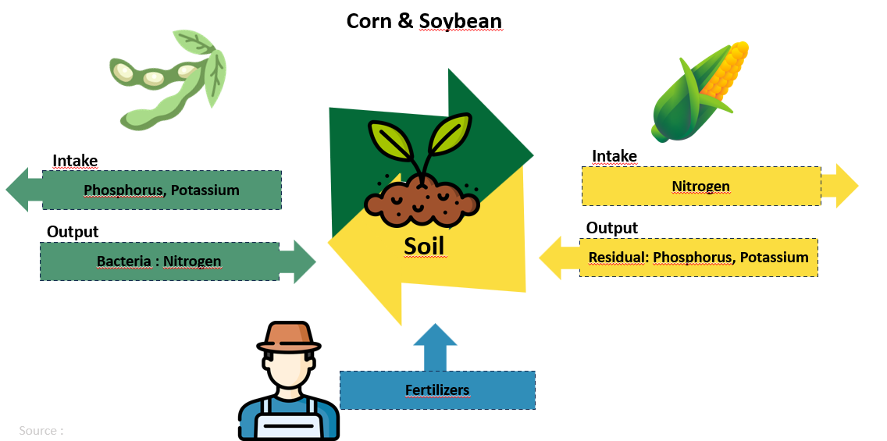
What Can We Optimize?
2 Optimization Opportunities
Pest & Disease Control
C
C
Nothing

Slide 13
What Can We Optimize?
2 Optimization Opportunities
Pest & Disease Control
C
C
Nutrient Amendment
Nothing
A
A

Slide 14
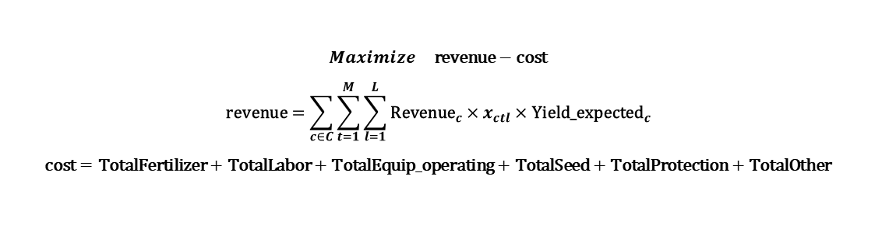
What Can We Optimize?
2 Optimization Opportunities
Pest & Disease Control
C
C
Nutrient Amendment
Nothing
A
A
$$Maximize \text{revenue}−\text{cost}$$
$$\text{revenue}=\sum_{c∈C}{\sum_{t=1}^{M}{\sum_{l=1}^{L}{{\text{Revenue}}_{c}}}}×x_{ctl}×{\text{Yield}\text{_}\text{expected}}_{c}$$
$$\text{cost}=\text{TotalFertilizer}+\text{TotalLabor}+\text{TotalEquip}\text{_}\text{operating}+\text{TotalSeed}+\text{TotalProtection}+\text{TotalOther}$$

Slide 15
Gathering Diversified Data
Crop
Family
Growth Season
Sell Price ($/bu)
Labor ($/ac)
Equipment ($/ac)
Protection ($/ac)
Others
($/ac)
Lentils
Papilionacea
Summer
0.49
20.25
41.13
56.16
198.81
Canola
Brassicaceae
Summer
17.61
21.50
30.47
66.93
198.81
Summer Wheat
Poacea
Summer
10.15
22.75
29.35
56.10
198.81
Oat
Poacea
Summer
5.19
22.25
31.59
25.25
198.81
Winter Rye
Poacea
Winter
7.92
21.25
29.35
27.84
198.81
Hairy Vetch
Vicia Villosa
Winter
2.00
20.25
38.24
25.10
198.81
Notes:
We had to research data – No need to understand all prices here, what you need to notice is that there is some similarities and some differences. We selected crops that grows in saskatchewan and that have different values/similarities in order to fully harness the potential of our model

Slide 16

Providing the Real-World Logic
Defining Parameters for our Farm
Telling Gurobi How a Farm Works
Constraint Logic
How it restrains the model
One Crop per Plot
Prohibits a plot being split in two for two crops
Plot Status
The model track if for a month a plot is available
4 plots of 401 acres each
Period of 36 months
Duration Enforcement
Prohibits another crop to be planted if a plot is in usage
Budget of $4.5M over 3 years
Full Growth Cycle Achieved
Model verifies sufficient season time before planting
Notes:
Now that we have the data, we needed to set gurobi. We told gurobi how a farm works and more precisely what does our farm look like.
Had to tell gurobi how a farm works --------Following that slide should be all the constraint (then tell gurobi to take into account all constraint related to crop rotation)

Slide 17
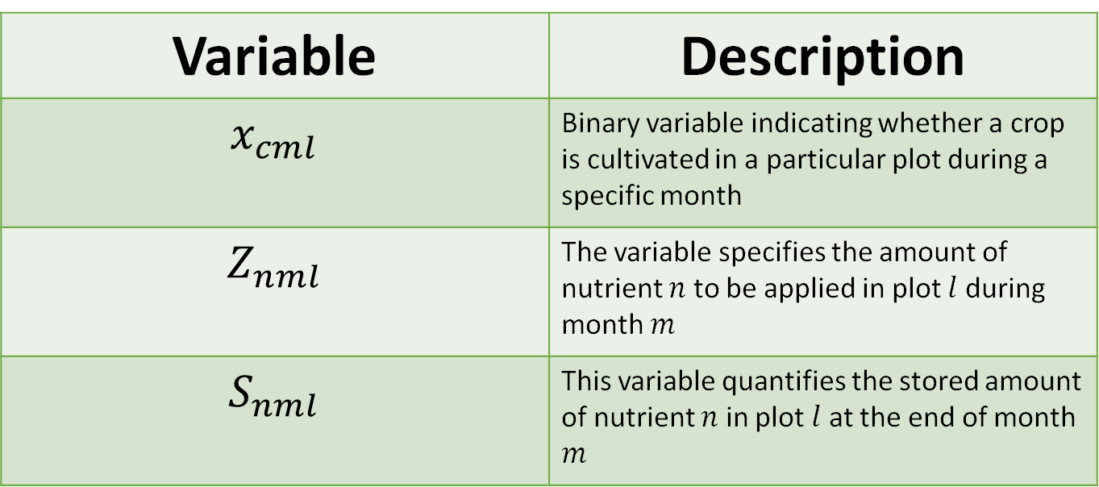
What Decision is Gurobi Taking?
Decision Variables:
Variable | Description
$$x_{cml}$$ | Binary variable indicating whether a crop is cultivated in a particular plot during a specific month
$$Z_{nml}$$ | The variable specifies the amount of nutrient $n$ to be applied in plot $l$ during month $m$
$$S_{nml}$$ | This variable quantifies the stored amount of nutrient $n$ in plot $l$ at the end of month $m$

Slide 18
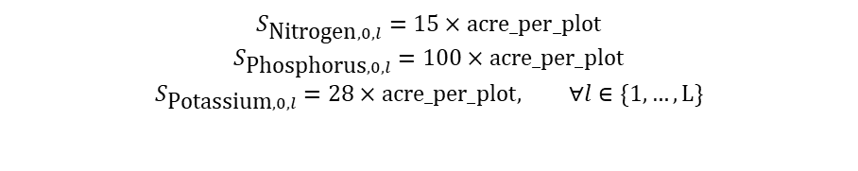
How do we Optimize for…
Nutrient Amendment
A
Research says
Implemented by considering
Formulating these aspects in our model is necessary for the following reasons:
Meeting plant nutrient requirements is necessary for optimal growth
Understanding soil nutrient storage is key to maintaining soil health
Supports long-term agricultural sustainability
Mathematical Formulation
Initial Soil Storage
$$S_{\text{Nitrogen},0,l}=15×\text{acre}\text{_}\text{per}\text{_}\text{plot}$$
$$S_{\text{Phosphorus},0,l}=100×\text{acre}\text{_}\text{per}\text{_}\text{plot}$$
$$S_{\text{Potassium},0,l}=28×\text{acre}\text{_}\text{per}\text{_}\text{plot}, ∀l∈\{1,…,L\}$$
Minimum Nutrient Requirements
$${\text{nutrient}\text{_}\text{consumption}}_{cn}×x_{cjl}×\text{acre}\text{_}\text{per}\text{_}\text{plot}≤Z_{njl}+S_{njl}, ∀c∈C,∀n∈\text{nutrients},∀j∈M,∀l∈L$$
Cost of Fertilizers
Nitrogen : 0.50$ per pound
Phosphorus : 0.55$ per pound
Updating Nutrient Storage Levels
Potassium : 0.66$ per pound

Slide 19
How do we Optimize for…
Nutrient Amendment
A
Research says
Implemented by considering
Formulating these aspects in our model is necessary for the following reasons:
Meeting plant nutrient requirements is necessary for optimal growth
Understanding soil nutrient storage is key to maintaining soil health
Supports long-term agricultural sustainability
Mathematical Formulation
Initial Soil Storage
$$S_{\text{Nitrogen},0,l}=15×\text{acre}\text{_}\text{per}\text{_}\text{plot}$$
$$S_{\text{Phosphorus},0,l}=100×\text{acre}\text{_}\text{per}\text{_}\text{plot}$$
$$S_{\text{Potassium},0,l}=28×\text{acre}\text{_}\text{per}\text{_}\text{plot}, ∀l∈\{1,…,L\}$$
Each plot must start with a defined quantity of nitrogen, potassium, and phosphorus.
Minimum Nutrient Requirements
The amount of nutrients applied is at least as much as the crop needs.
$${\text{nutrient}\text{_}\text{consumption}}_{cn}×x_{cjl}×\text{acre}\text{_}\text{per}\text{_}\text{plot}≤Z_{njl}+S_{njl}, ∀c∈C,∀n∈\text{nutrients},∀j∈M,∀l∈L$$
Cost of Fertilizers
Nitrogen : 0.50$ per pound
Updating Nutrient Storage Levels
Phosphorus : 0.55$ per pound
Update nutrient storage levels for each plot on a monthly basis.
Potassium : 0.66$ per pound

Slide 20

How do we Optimize for…
Nutrient Amendment
A
Updating Nutrient Storage Levels
Research says
Implemented by considering
Math formulation
$$\text{For} \text{each} \text{nutrient} n, \text{each} \text{month} j∈\{2,…,M\}, \text{and} \text{each} \text{plot} l∈\{1,…,L\}:$$
$${\text{nutrient}\text{_}\text{req}\text{_}\text{sum}}_{njl}=\sum_{c∈C}{\left({\text{nutrient}\text{_}\text{consumption}}_{cn}×x_{c,j−1,l}×\text{acre}\text{_}\text{per}\text{_}\text{plot}\right)},$$
If the nutrient is either potassium or phosphorus:
$$S_{njl}=S_{n,j−1,l}−{\text{nutrient}\text{_}\text{req}\text{_}\text{sum}}_{njl}+Z_{n,j−1,l}×\sum_{c∈C}{x_{c,j−1,l}},$$
If the nutrient is nitrogen:
$${\text{residual}\text{_}\text{nutrient}\text{_}\text{sum}}_{njl}=\sum_{c∈C}{\left(\text{acre}\text{_}\text{per}\text{_}\text{plot}×{\text{nitrogen}\text{_}\text{production}}_{c}×x_{cjl}\right)},$$
$$S_{njl}=S_{n,j−1,l}−{\text{nutrient}\text{_}\text{req}\text{_}\text{sum}}_{njl}+{\text{residual}\text{_}\text{nutrient}\text{_}\text{sum}}_{njl}+Z_{n,j−1,l}×\sum_{c∈C}{x_{c,j−1,l}}.$$
Soil Storage
A dynamic equation computes organic nutrients intake and output
Fertilizers
The equation also computes fertilizers amendment

Slide 21
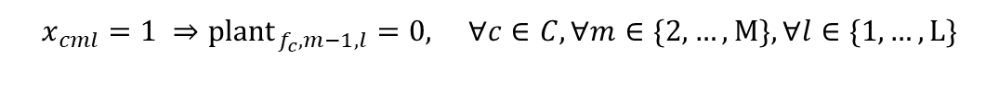
How do we Optimize for…
Pest & Disease Control
A
C
Research says
Implemented by considering
The following constraints are necessary for the following reasons:
Disrupting pest and disease cycles
Diseases include Powdery Mildew (canola and lentils) and Fusarium Head Blight (wheat)
Preserving soil structure and health
Maintain soil nutrient balance
Mathematical Formulation
Avoid sequential planting of the same crop family
$$x_{cml}=1 ⇒{\text{plant}}_{f_{c},m−1,l}=0, ∀c∈C,∀m∈\{2,…,M\},∀l∈\{1,…,L\}$$
Plot adjacency
$$x_{cml}+x_{c^{′}tp^{′}}≤1, ∀c,c^{′}∈C, \text{with} c^{′}∈F\left[f_{c}\right],∀m∈\{1,…,M\},∀l,p^{′}∈L,p^{′}∈A\left[l\right],∀t∈T_{cm}$$
$$T_{cm}=\left\{t:\max\left(0,m−{\text{duration}}_{c^{′}}+1\right)≤t≤\min\left(m+{\text{duration}}_{c}−1,M\right)\right\}$$
Botanical Family

Slide 22
How do we Optimize for…
Pest & Disease Control
C
Research says
Implemented by considering
The following constraints are necessary for the following reasons:
Disrupting pest and disease cycles
Diseases include Powdery Mildew (canola and lentils) and Fusarium Head Blight (wheat)
Preserving soil structure and health
Maintain soil nutrient balance
Mathematical Formulation
Avoid sequential planting of the same crop family
No two crops from the same family can be planted sequentially.
$$x_{cml}=1 ⇒{\text{plant}}_{f_{c},m−1,l}=0, ∀c∈C,∀m∈\{2,…,M\},∀l∈\{1,…,L\}$$
Plot adjacency
$$x_{cml}+x_{c^{′}tp^{′}}≤1, ∀c,c^{′}∈C, \text{with} c^{′}∈F\left[f_{c}\right],∀m∈\{1,…,M\},∀l,p^{′}∈L,p^{′}∈A\left[l\right],∀t∈T_{cm}$$
$$T_{cm}=\left\{t:\max\left(0,m−{\text{duration}}_{c^{′}}+1\right)≤t≤\min\left(m+{\text{duration}}_{c}−1,M\right)\right\}$$
No crops from the same family can be planted on adjacent plots.
Botanical Family
Tracks which botanical family of crops is planted on each plot for every month.

Slide 23

How do we Optimize for…
Nutrient Amendment
A
Botanical Family
$$\text{For} \text{each} \text{month} m∈\{1,…,M\}, \text{and} \text{each} \text{plot} l∈\{1,…,L\}:$$
$${\text{is}\text{_}\text{planted}}_{ml}=\text{Binary} \text{variable} \text{indicating} \text{if} \text{any} \text{crop} \text{is} \text{planted} \text{on} \text{plot} l \text{in} \text{month} m,$$
$$\text{For} \text{each} \text{family} f∈F:$$
$$\text{If} m=1:$$
$${\text{plant}}_{fml}=\sum_{c∈C,c∈F\left[f\right]}{x_{cml}},$$
$$\text{Else}\text{:}$$
$${\text{prev}\text{_}\text{plant}}_{fl}={\text{plant}}_{f,m−1,l},$$
$${\text{plant}}_{fml}≤\sum_{c∈C,c∈F\left[f\right]}{x_{cml}}+\text{big}\text{_}\text{M}×\left(1−{\text{is}\text{_}\text{planted}}_{ml}\right),$$
$${\text{plant}}_{fml}≥\sum_{c∈C,c∈F\left[f\right]}{x_{cml}}−\text{big}\text{_}\text{M}×\left(1−{\text{is}\text{_}\text{planted}}_{ml}\right),$$
$${\text{plant}}_{fml}≤{\text{prev}\text{_}\text{plant}}_{fl}+\text{big}\text{_}\text{M}×{\text{is}\text{_}\text{planted}}_{ml},$$
$${\text{plant}}_{fml}≥{\text{prev}\text{_}\text{plant}}_{fl}−\text{big}\text{_}\text{M}×{\text{is}\text{_}\text{planted}}_{ml}.$$
Research says
Implemented by considering
Math formulation
Soil Storage
A dynamic equation computes organic nutrients intake and output
Fertilizers
The equation also computes fertilizers amendment

Slide 24
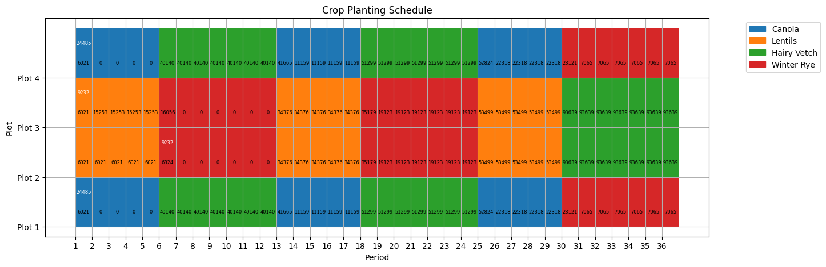
Result Showcasing Efficiencies
Plots
Plot adjacency
1
2
3
4
Months
May
Nitrogen Plot
May-Sept of Y1
Overall Revenue: $ 5,506,394.75 Total cost $ 4,410,411.93
Overall Profit: $ 1,095,982.82
Nitrogen Amendment in White
Canola
Lentils
Lentils
Canola
Nitrogen Storage in Black

Slide 25
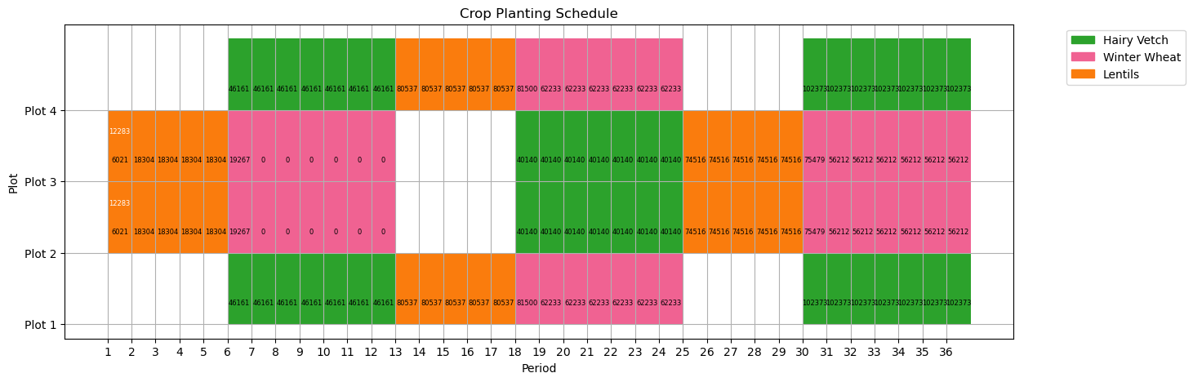
Problem Extension
Plots
Plot adjacency
1
2
3
4
Months
May
May-Sept of Y1
Overall Revenue: $ 3,240,829.12 Total cost $ 3,178,261.12
Overall Profit: $ 62,568.00
Uncertainty in Yield (50/50)
Nothing
Lentils
Cover Crop: Hairy Vetch
Lentils
Nothing

Slide 26
A Tool Worth Sharing
Guiding Aspiration:
Optimize Profit Leveraging Crop Rotation
Question:
What Crop?
Where?
When?
Considering:
Revenue
Adjacency
Growth Period
Cost
Soil Nutrients
Season

Slide 28
SLIDE GRAVEYARD FOLLOWS

Slide 29
Okay but isn’t crop rotation already known?
done
On our way to solve the problem:
Before lecturing anyone, let’s start here
Governement now subsidizes Sask farmer– Gov is pushing
Sask is bread basket of Canada 40%
Current state is that there is some crop rotation but it’s not based on anything
Development: 1. Monoculture 2.Crop rotation 3.Crop rotation optimization
Notes:
At this point of the presentation, you might tell us that crop rotation is a well known approach. Sure. But but it hasn’t been optimized for yet. We are not here to reivent the wheel, but we have some suggestion to modernize it!

Slide 30
done
Need a cycle that tells about crop rotation benefits
Then we copy paste that cycle and highlight were optimization can come in (what impact it would have)
And then we keep refering to this schema for each part
-To introduce the constraint related to crop selection
-To introduce constraint related to nutrient amendment
-Adjency constraint for pest (make two schema side by side)

Slide 31
done
Same schema but with identification of where our model can intervene to optimize

Slide 32
done
Where do we want to intervene with our optimization model?

Slide 33



Slide 34
Setting initial parameters for our model (as in report)
DONE

Slide 36
Gathering Diversified Data
Crop Data
Experiment data
Crop
Family
Growth Season
Price ($/bu)
Lentils
Papilionacea
Summer
0.49
Canola
Brassicacea
Summer
17.61
4 plots of 446 acres each
Weath
Poacea
Summer
10.15
Period of 36 months
Oat
Poacea
Summer
5.19
Winter Rye
Poacea
Winter
7.92
Budget of $1M
Hairy Vetch
Vicia Villosa
Winter
2.00
Fixed Cost of
Fix price for fixed cost
Notes:
We had to research data

Slide 37
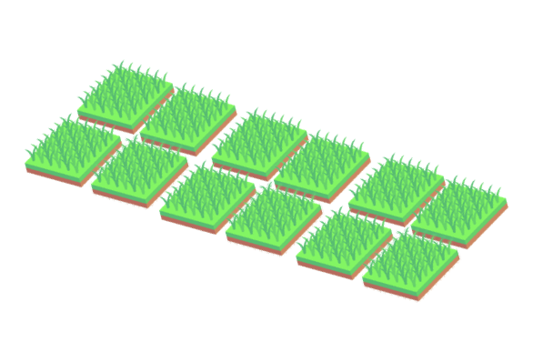
One crop for one plot, when a plot is busy you can plant on it …
Giving the farm context to the model

Slide 38
Gathering Diversified Data
Crop Data
Experiment data
Crop
Family
Growth Season
Price ($/bu)
Lentils
Papilionacea
Summer
0.49
Canola
Brassicacea
Summer
17.61
4 plots of 446 acres each
Weath
Poacea
Summer
10.15
Period of 36 months
Oat
Poacea
Summer
5.19
Winter Rye
Poacea
Winter
7.92
Budget of $1M
Hairy Vetch
Vicia Villosa
Winter
2.00
Fixed Cost of
Fix price for fixed cost
Notes:
We had to research data

Slide 39
Put the months (2 planting season)
Presenting results
Summer 1
Winter 1
Summer 1
Winter 1
Plot 1
Plot 2
Plot 1
Plot 2
Plot 1
Plot 2
Plot 1
Plot 2
Plot 3
Plot 4
Plot 3
Plot 4
Plot 3
Plot 4
Plot 3
Plot 4
Put the months (2 planting season)
Proving that all constraints are met

Slide 40
Model expansion

Slide 41
If revenue bigger than
Show soil memory show in the presentation residual

Slide 42
Slide that explain all the variable together with scheme

Slide 43
Conclusion:
Just hope we’ve planted a seed

Slide 44
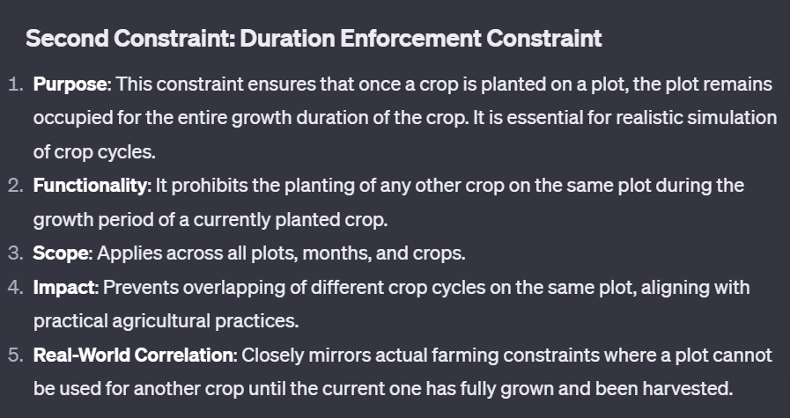
Get this for all constraint in appendix

